Slide 1
Clean code
Dragoș Petrașcu
Software Architect
Fortech, a GlobalLogic Company

Slide 2
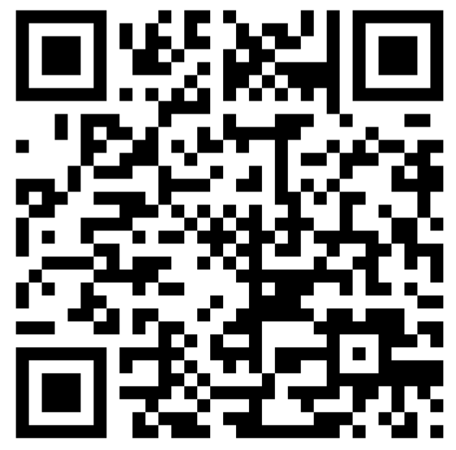
Before we start…
Hackathon
25th November

Slide 3
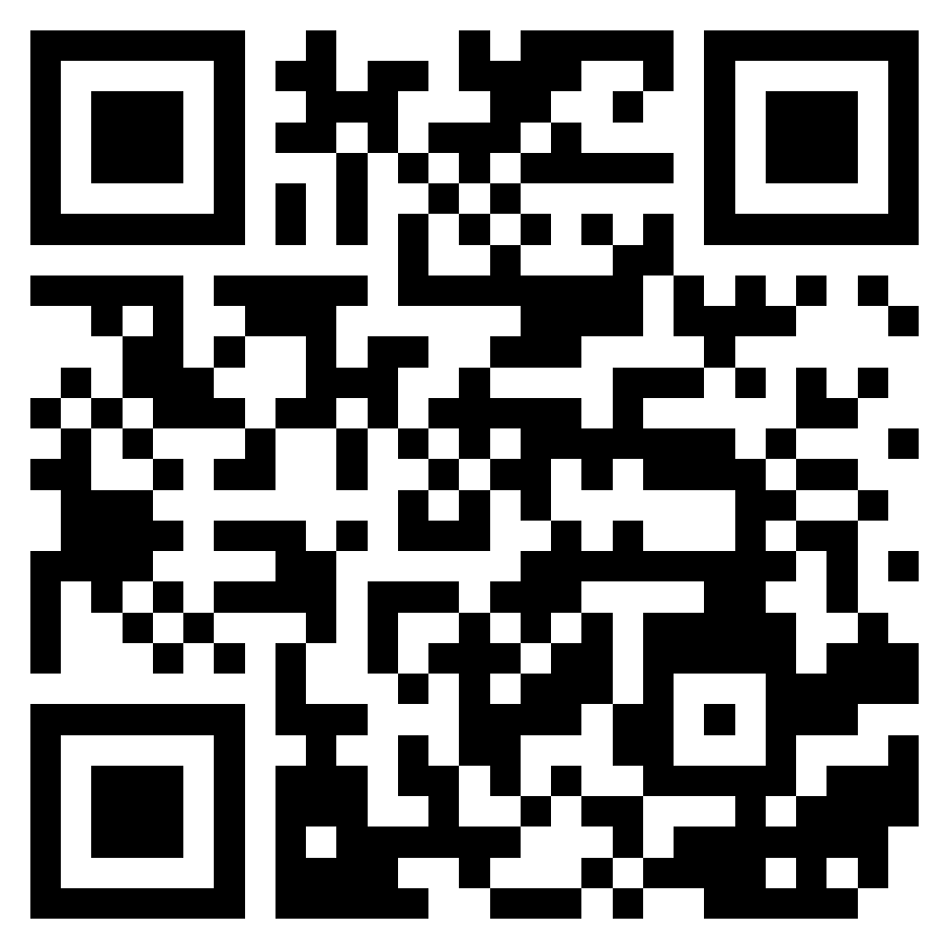
About me
https://www.linkedin.com/in/dragospetrascu/

Slide 4
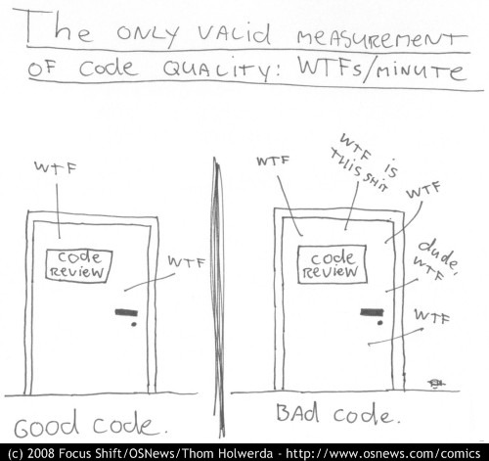
Code Quality measurement

Slide 5
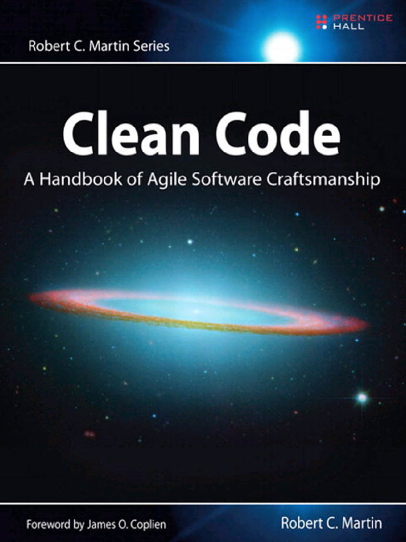

Clean Code A Handbook of Agile Software Craftsmanship

Slide 6
About Clean Code
Clean Code is a set of principles and practices in software development that emphasizes the creation of code that is not only functional but also easily readable, maintainable, and elegant.
It focuses on writing code that is clear, concise, and well-structured, with meaningful variable names, well-defined functions, and adherence to consistent coding styles.
Clean Code is a crucial aspect of software craftsmanship, promoting the development of software systems that are easy to understand, modify, and collaborate on.
It reduces technical debt, minimizes the likelihood of bugs, and enhances the long-term sustainability of software projects, making it an essential component of effective software engineering.

Slide 7
The Boy Scout Rule
Leave the campground cleaner than you found it.
Try and leave this world a little better than you found it.
adapted from Robert Stephenson Smyth Baden-Powell’s farewell message to the Scouts
The Boy Scouts of America have a simple rule that we can apply to our profession.

Slide 8
Hot topics
Code Smells: Recognizing and addressing common code smells like long methods, large classes, and excessive parameters.
Meaningful Names: Using descriptive and clear names for variables, functions, classes, and modules to enhance code readability and understanding.
Functions: Keeping functions small, focused, and doing one thing, and using descriptive function names.
Comments: Writing clear and concise comments only when necessary, with an emphasis on self-explanatory code.
Formatting: Consistently formatting code, including indentation, line lengths, and spacing, to make the code visually clean and easy to follow.
Don't Repeat Yourself (DRY): Avoiding code duplication by encapsulating repeated logic in functions, classes, or modules.
SOLID Principles: Adhering to the SOLID principles (Single Responsibility, Open/Closed, Liskov Substitution, Interface Segregation, Dependency Inversion) to promote maintainability and extensibility.

Slide 9
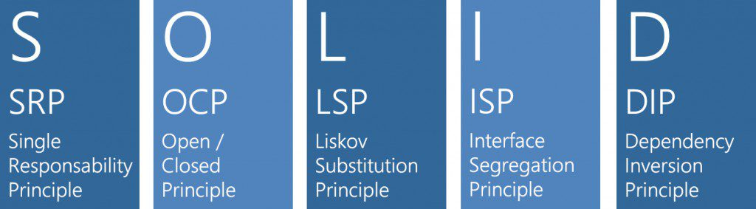
SOLID Principles

Slide 10

Single-responsibility principle
A class should have only one reason to change.

Slide 11
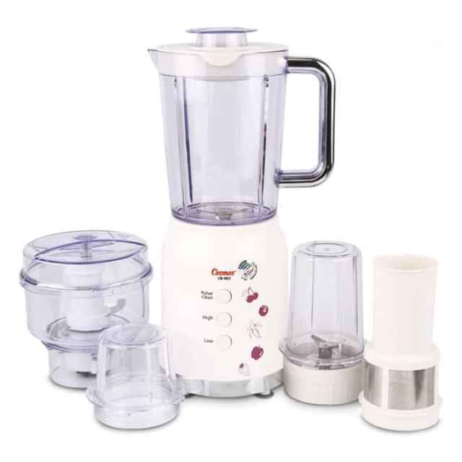
Open-closed principle
Software entities (classes, modules, functions) should be open for extension, but closed for modification.

Slide 12
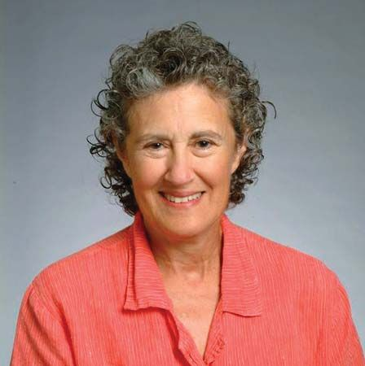
Liskov substitution principle
An object (such as a class) may be replaced by a sub-object (such as a class that extends the first class) without breaking the program.

Slide 13
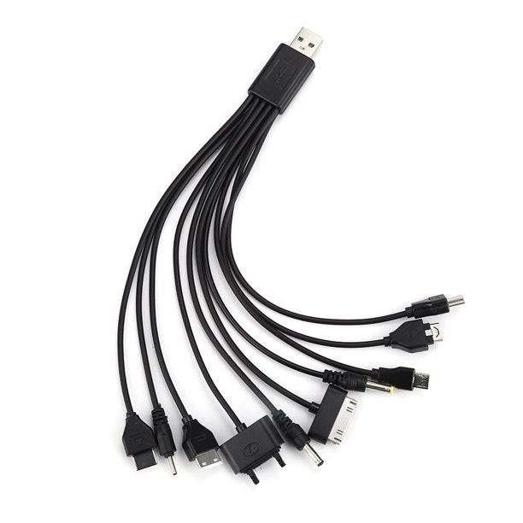
Interface segregation principle
No code should be forced to depend on methods it does not use.

Slide 14

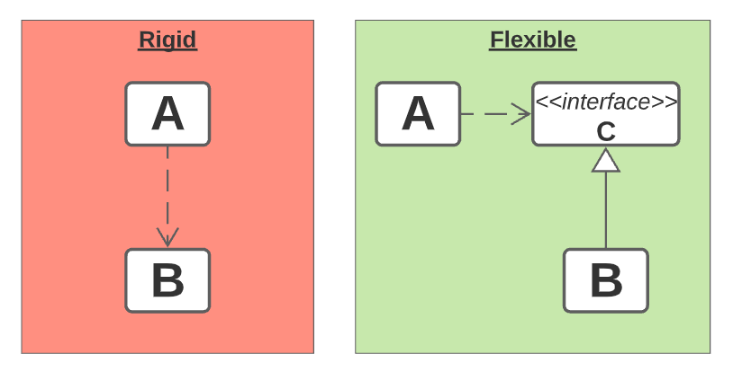
Dependency inversion principle
High-level modules should not import anything from low-level modules. Both should depend on abstractions (e.g., interfaces).
Abstractions should not depend on details. Details (concrete implementations) should depend on abstractions.

Slide 15
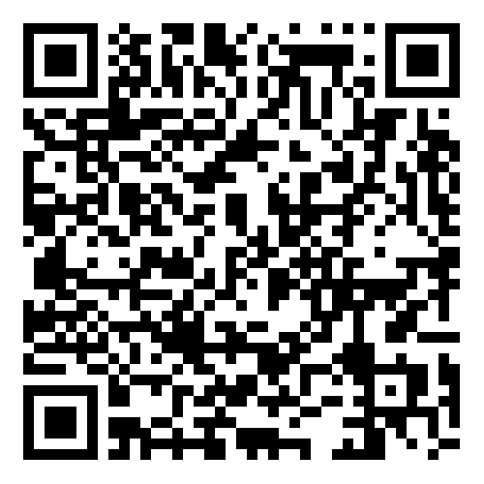
Live coding session
https://github.com/fortech-practice/utcn-2023-11-22-clean-code

Slide 16


Slide 17
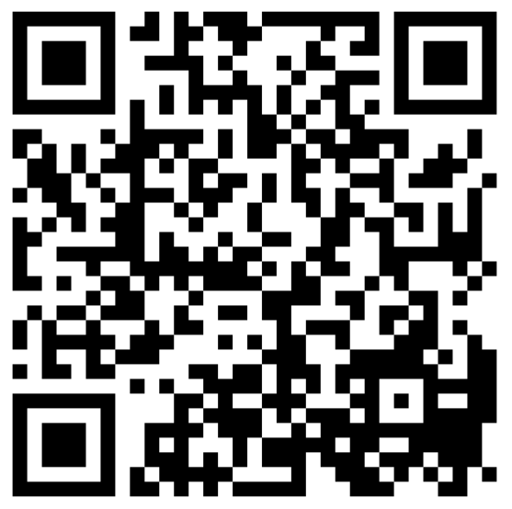
FEEDBACK FORM

Slide 18
+40 264 453 303
dragos.petrascu@globallogic.com
www.fortech.ro

